Slide 1


A novel transformer-based approach for estimating causal interaction in multichannel electroencephalographic data
Relatore: Prof.ssa Laura Astolfi
Correlatore: Prof. Nicola Toschi
Controrelatore: Prof. Luca Iocchi
Luca Maurici 1809678
Master Thesis – M.Sc. in Artificial Intelligence and Robotics
Notes:
Questa slide dovrebbe contenere le stesse informazioni del frontespizio della tesi (inclusi i riferimenti a relatore, correlatore e controrelatore)

Slide 2

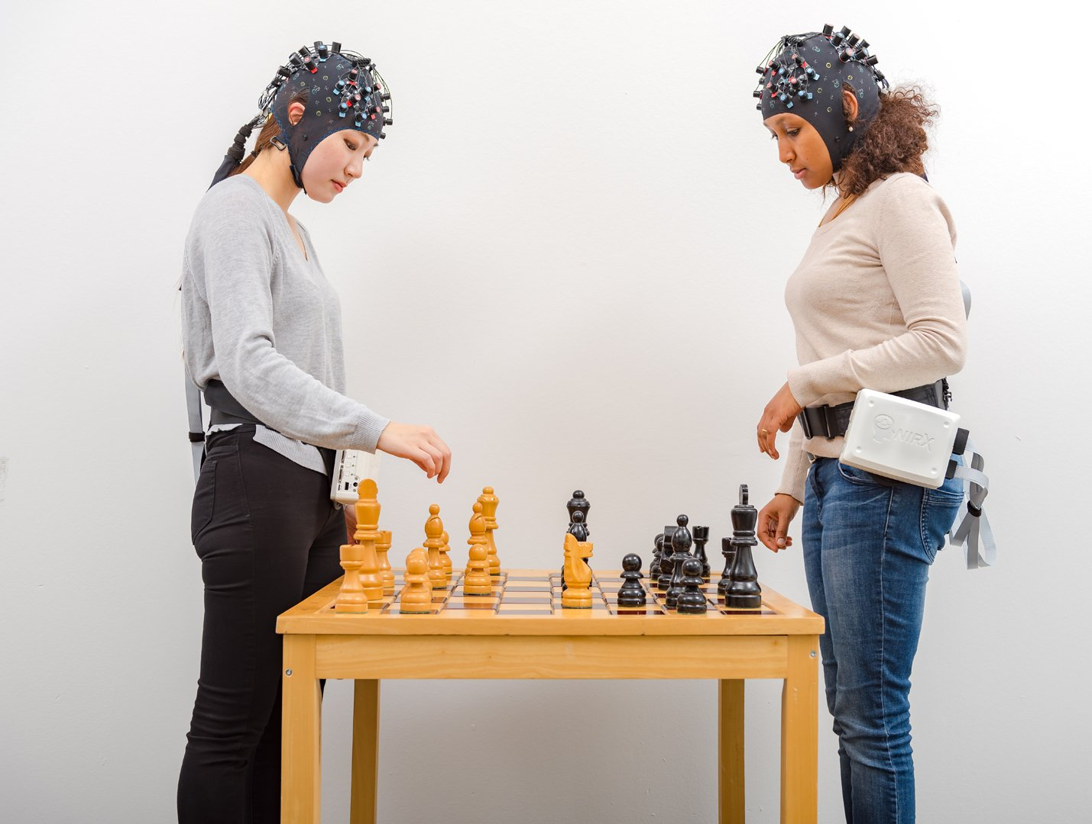
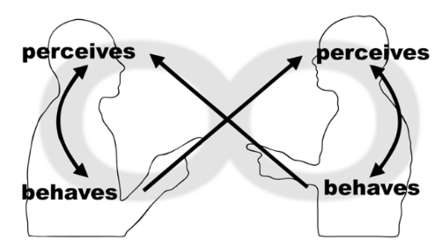
Introduction – EEG Hyperscanning
Simultaneous acquisition of brain signals on two (or more) subjects during their interaction.
Interdependencies between the two sets of brain signals can reveal brain processes that support the interaction.
EEG hyperscanning allows more natural, face-to-face interaction and follows the brain dynamics with an excellent time resolution.

Slide 3
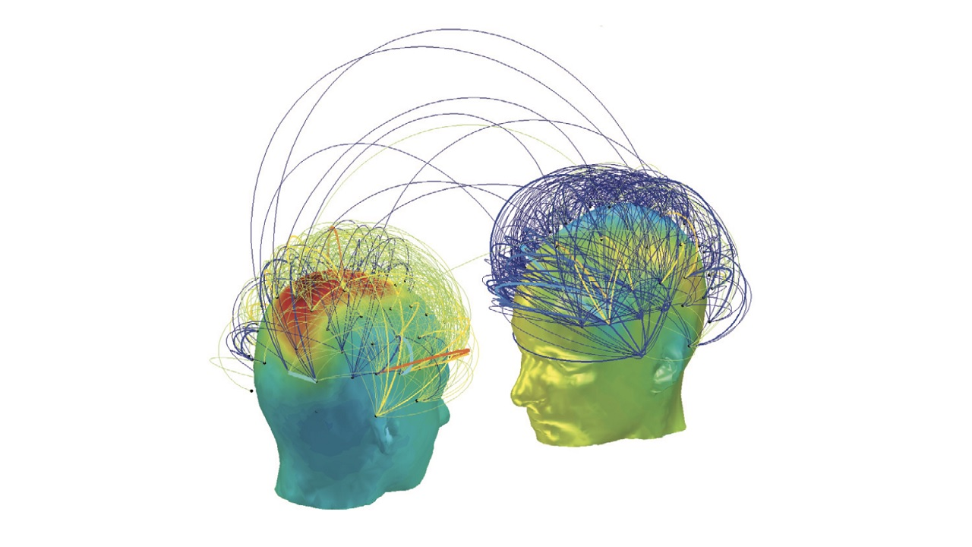
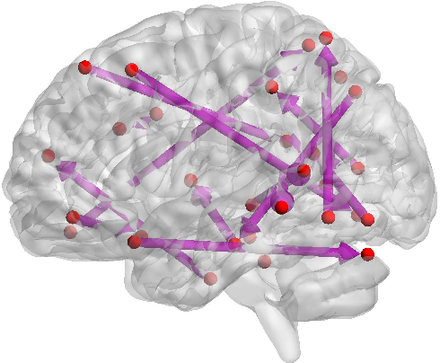
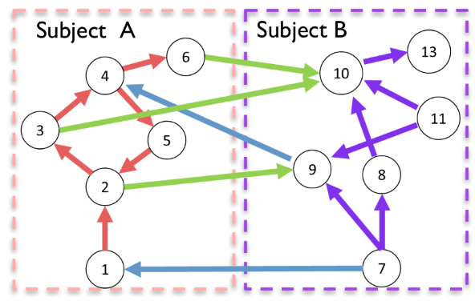
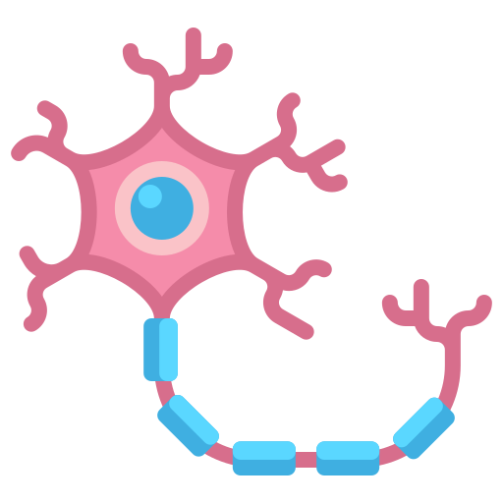
Introduction – Causality in hyperscanning
Neurons
cause activity
other neurons
0
200
Time (ms)
100
250
50
150
300
350
400
Notes:
La scala temporale è più o meno sensata?

Slide 4
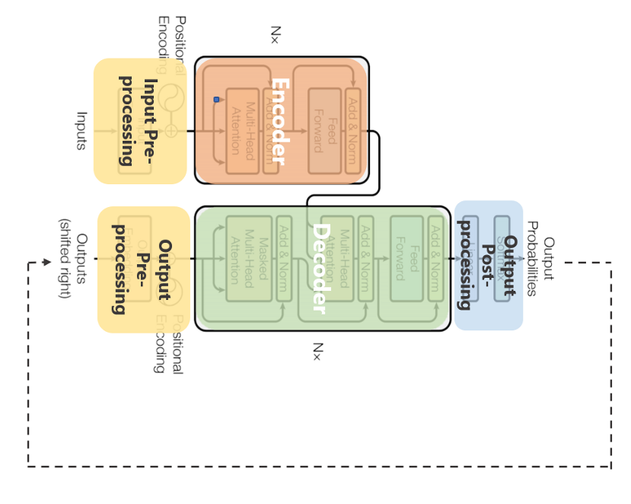
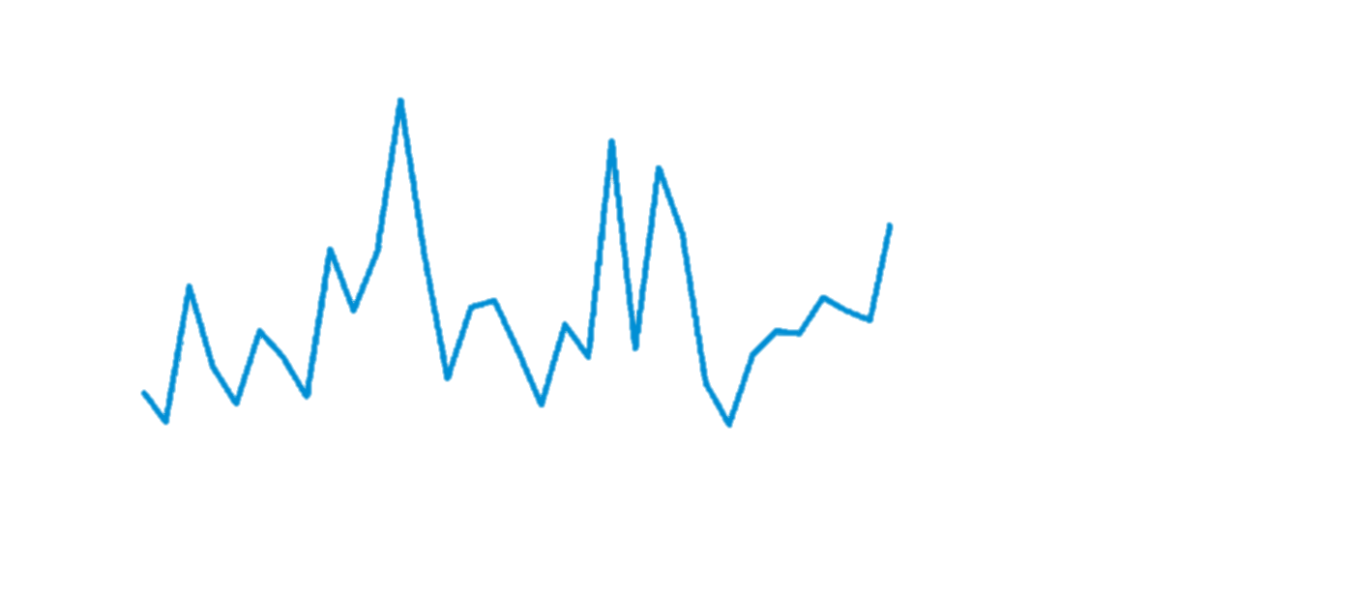
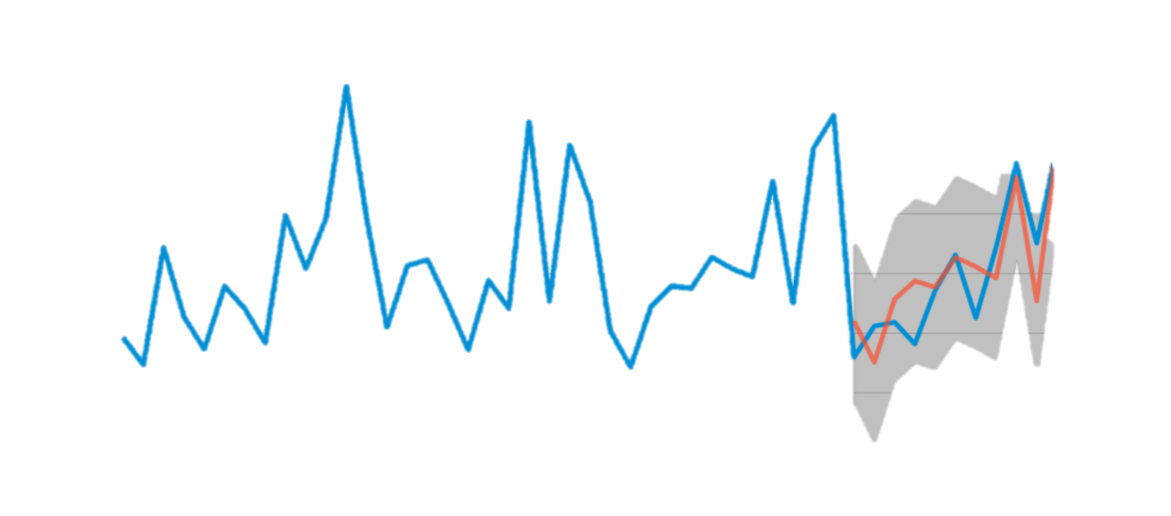
Introduction – Basic of Transformers
The pen is on the table
La penna è sul tavolo
Notes:
An attention mechanism is a technique that enhances the values of some portion of the input data while diminishing others. The rationale is that it is often convenient to pay more attention to some small but important part of the data, depending on the context. Mathematically, an attention function maps a query vector and a set of key-value vector pairs to an output vector. It is calculated as a weighted sum of the values, with each value's weight determined by the query's compatibility function with its corresponding key.
The transformer architecture, instead of using a single attention mechanism per layer, uses more than one in parallel (Figure 7 (right)). It has proven useful to linearly project queries, keys, and values h times, using distinct linear projections learned of dimensions dk, dk, and dv, instead of executing a single attention function with keys, values, and queries of dimension.

Slide 5
Aims
Propose two novel methods
Method 1: Conditioned Granger Causality based on Spacetimeformer residuals
Assess feasibility of the novel approach, using synthetic EEG data as a benchmark, to compare results with a ground truth.
Method 2: Attention matrices as measure of causality
Assess the plausibility of this novel method by applying it to real hyperscanning EEG data.
Notes:
The hypothesis is that the novel approach can show performances comparable to those of the Linear Conditioned Granger causality method.
The application of the method on real data is dependent on computational times, which are expected to be a possible criticality.
Computational times are expected to be sensibly lower.

Slide 6
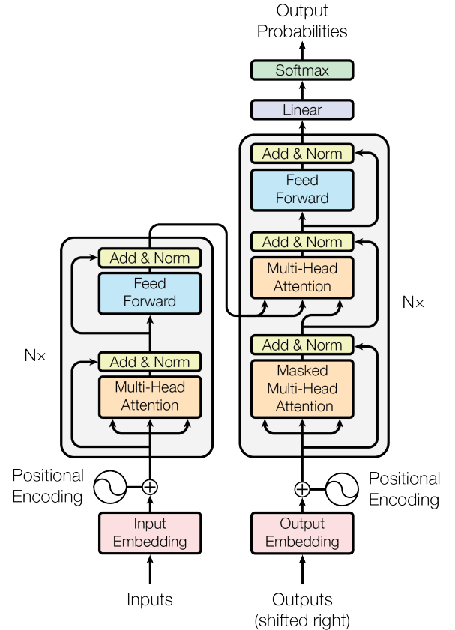
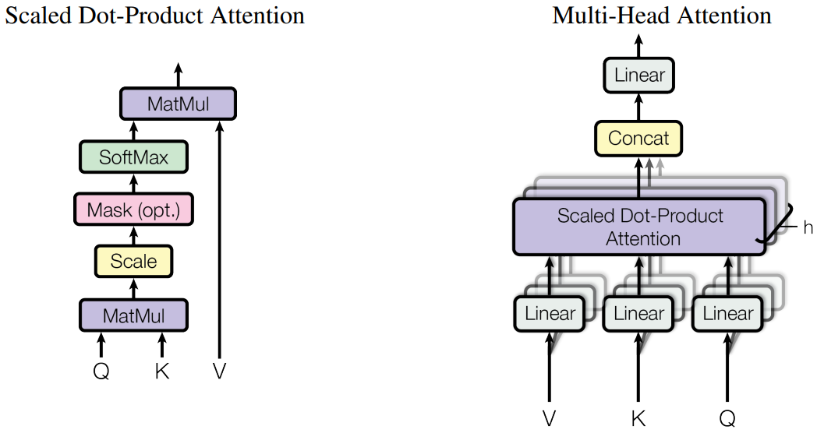

Methods – Transformers
$$Attention\left(Q, K, V \right)= soft\max\left(\frac{QK^{T}}{\sqrt{d_{k}}} \right)V$$
Notes:
An attention mechanism is a technique that enhances the values of some portion of the input data while diminishing others. The rationale is that it is often convenient to pay more attention to some small but important part of the data, depending on the context. Mathematically, an attention function maps a query vector and a set of key-value vector pairs to an output vector. It is calculated as a weighted sum of the values, with each value's weight determined by the query's compatibility function with its corresponding key.
The transformer architecture, instead of using a single attention mechanism per layer, uses more than one in parallel (Figure 7 (right)). It has proven useful to linearly project queries, keys, and values h times, using distinct linear projections learned of dimensions dk, dk, and dv, instead of executing a single attention function with keys, values, and queries of dimension.

Slide 7
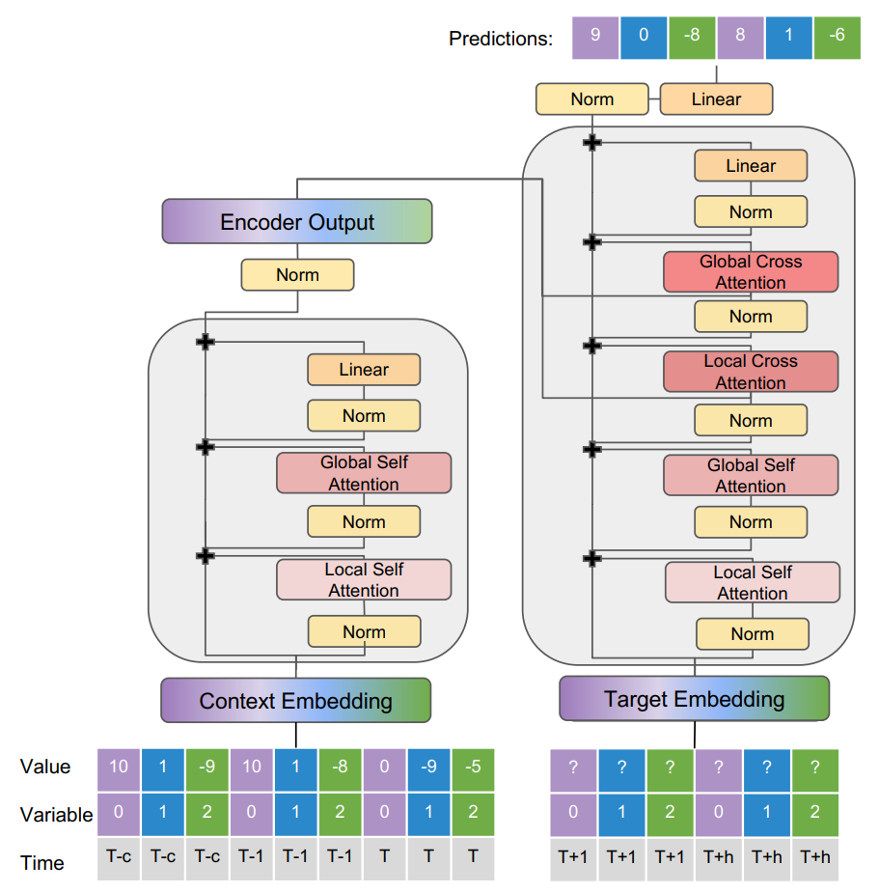
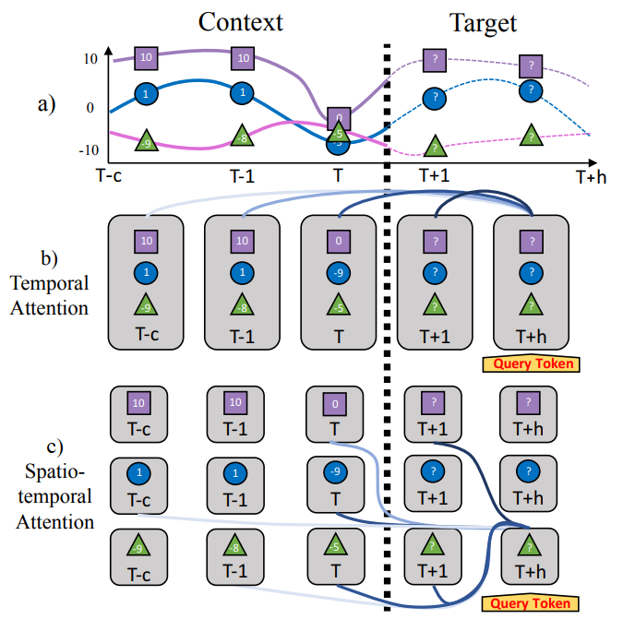
Methods - Spacetimeformer
Transformer
Spacetimeformer
Notes:
The goal is to assess the feasibility of the novel approach, using synthetic EEG data as a benchmark to compare results with a ground truth. The hypothesis is that the novel approach can show performances comparable to those of the Linear Conditioned Granger causality method. The application of the method on real data is dependent on computational times, which are expected to be a possible criticality.
Computational times are expected to be sensibly lower.
For this reason, the aim is to assess the plausibility of this novel method by applying it to real hyperscanning EEG data.

Slide 8
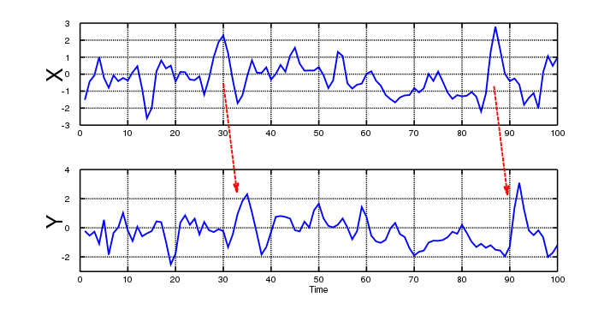
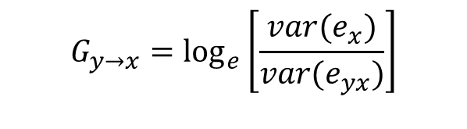
Methods – Wiener-Granger causality
Granger causality is based on the improvement of the predicting capability of a model by incorporating the past of a second signal. This is measured by the reduction of the residuals.
$$G_{y→x}=\log_{e}\left[\frac{var(e_{x})}{var(e_{yx})}\right]$$
Notes:
Given two simultaneously measured signals, if one can predict the first signal better by incorporating the past information from the second signal than using only information from the first one, then the second signal can be called causal to the first one (Wiener, 1956).

Slide 9
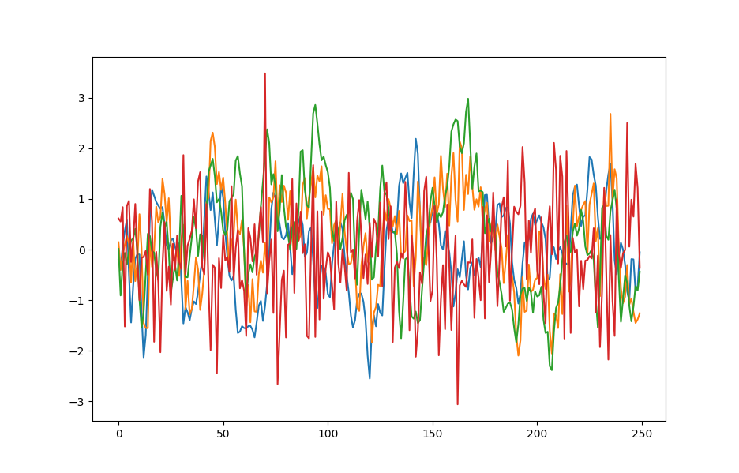
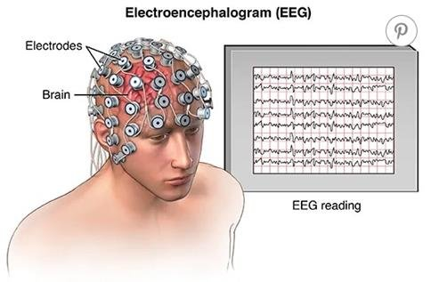
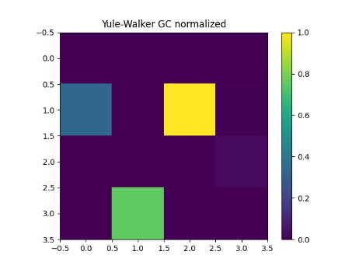
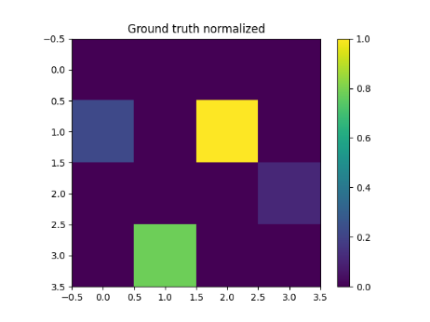

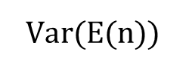
Method 1: CGC with Spacetimeformer
Synthetic EEG generation
Forecasted EEG
MVAR
MVAR
MVAR
$$G_{y→x}=\log_{e}\left[\frac{var(e_{x})}{var(e_{yx})}\right]$$
$$Var(E(n))$$
COMPARISON
Causality matrix
Ground truth
Notes:
Per misurare la riduzione dei residui nel caso multivariato è necessario effettuare un confronto fra n+1 modelli dove n è il numero di segnali

Slide 10

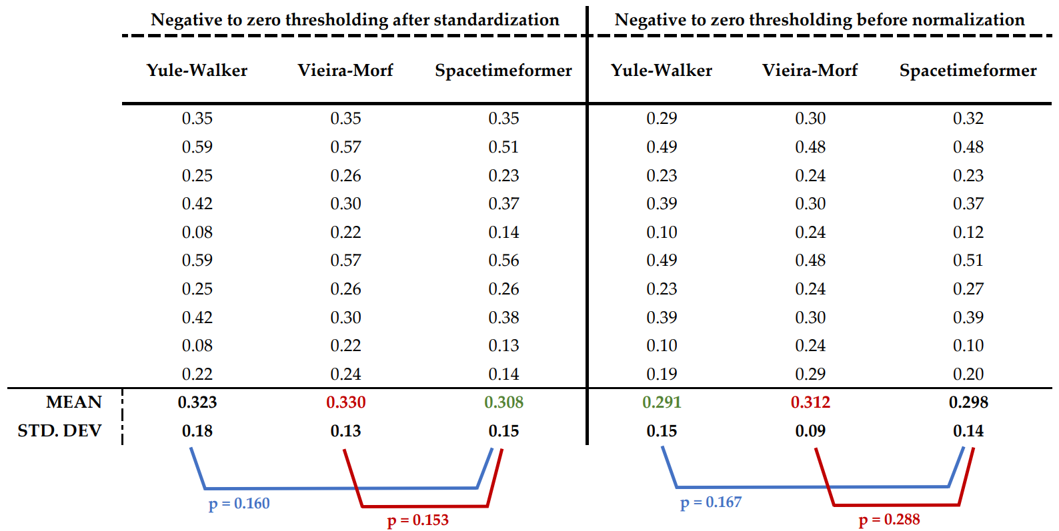
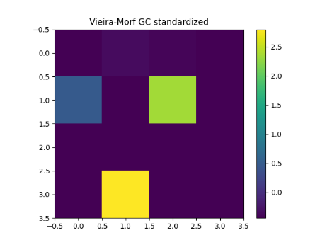

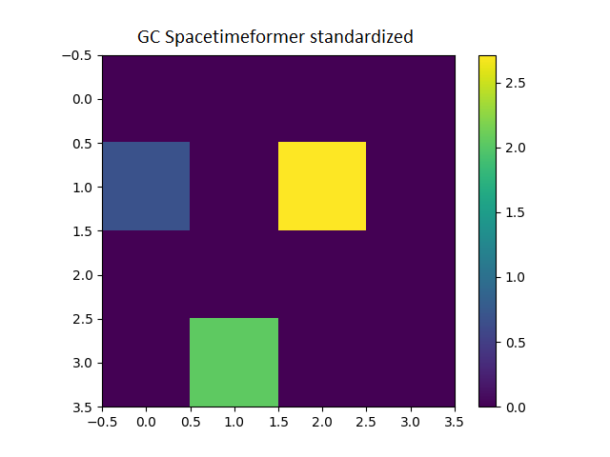


Results of Method 1
Standardized
Normalized
Yule walker
Vieira-Morf
Spacetimeformer
Ground truth
Notes:
The second aim is to leverage the explainability properties of the Spacetimeformer architecture to estimate brain connectivity by inspecting computed attention. My hypothesis is that the attention computed by the model may be seen as a form of causality in the predictive sense, and a combination of them may be used as the weights of the connectivity graph to be estimated.

Slide 11

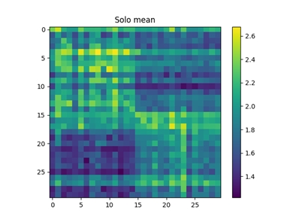
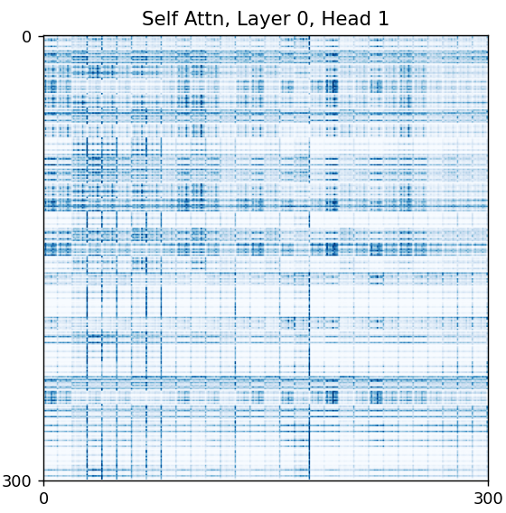
Method 2: Attention matrices as causality measure
Spacetimeformer
Forecasted EEG
Input EEG
aggregations
Causality matrix
Attention matrix
Notes:
The second aim is to leverage the explainability properties of the Spacetimeformer architecture to estimate brain connectivity by inspecting computed attention. My hypothesis is that the attention computed by the model may be seen as a form of causality in the predictive sense, and a combination of them may be used as the weights of the connectivity graph to be estimated.

Slide 12
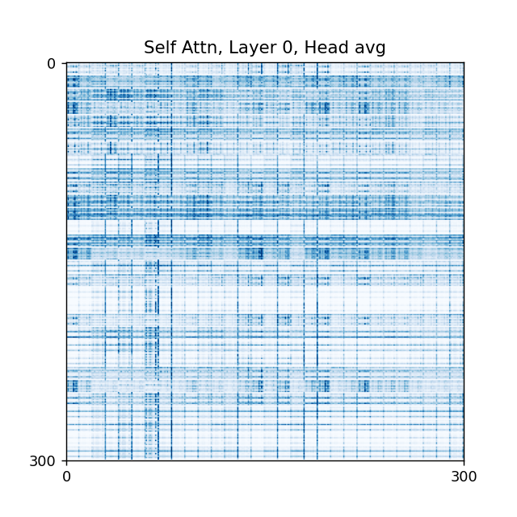
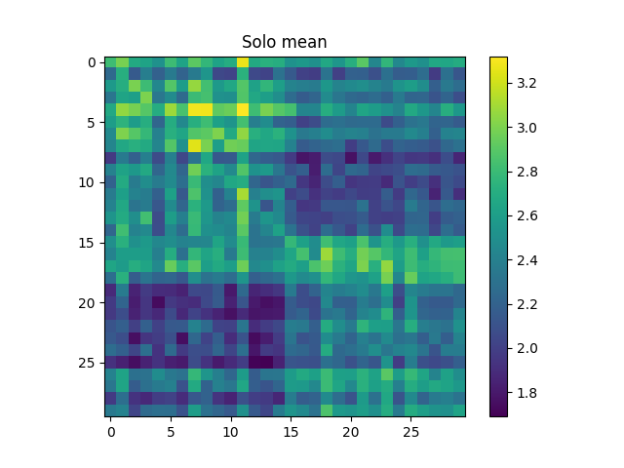
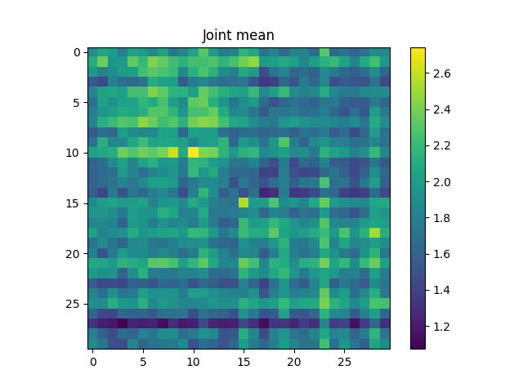
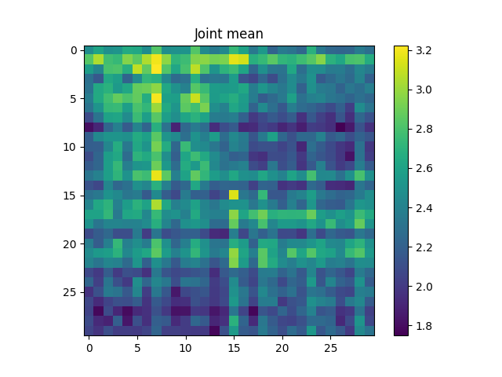
Method 2: Attention matrices
Types of aggregation considered
Cross-attention on Layer 0
Cross-attention on Layer 1
Average of cross-attentions
Element-wise product between cross-attentions
Self-attention on Layer 0
Self-attention on Layer 1
Average of self-attentions.
Element-wise product between self-attentions
Average of all the attention on every layer
Element-wise product between all the attention on every layer
Element-wise product between the averages of cross and self-attention
AVG along time
Aggregation
Attention matrices
Aggregation
AVG along time
Causality matrices
Notes:
The second aim is to leverage the explainability properties of the Spacetimeformer architecture to estimate brain connectivity by inspecting computed attention. My hypothesis is that the attention computed by the model may be seen as a form of causality in the predictive sense, and a combination of them may be used as the weights of the connectivity graph to be estimated.

Slide 13
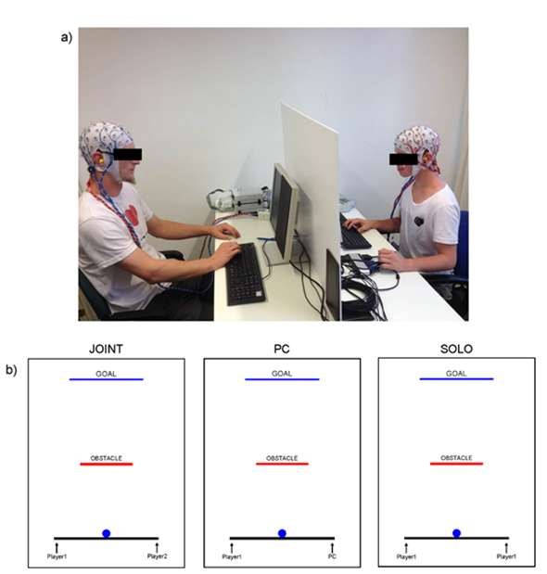
Method 2: Hyperscanning Joint experiment
Two conditions considered:
Solo experiment: each subject completed the task on their own, two fingers to control both sides of the virtual bar.
Joint experiment: the dyad worked on the same task together. Each participant used one finger to press a button to control one side of the virtual bar.
(Astolfi, et al., 2020)
The neuroelectrical hyperscanning recordings were performed with a 128-channel EEG acquisition system (64+64 channels) with a sampling frequency of 250 Hz
Notes:
The second aim is to leverage the explainability properties of the Spacetimeformer architecture to estimate brain connectivity by inspecting computed attention. My hypothesis is that the attention computed by the model may be seen as a form of causality in the predictive sense, and a combination of them may be used as the weights of the connectivity graph to be estimated.

Slide 14
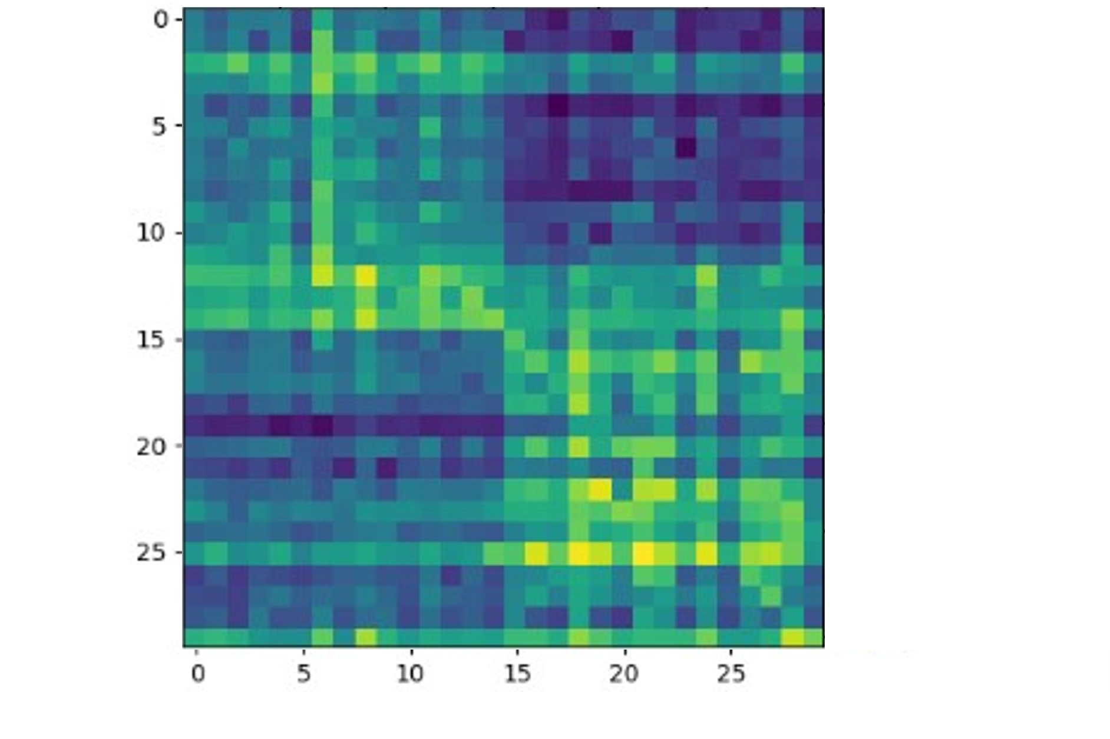
Method 2: Graph’s indices
Six graph’s indices
Sum of the intra-group connections
Sum of the inter-group connections
Weighted density of the intra-group connections
Weighted density of the inter-group connections
Divisibility
Modularity
SUB. A
SUB. B
SUB. A
SUB. B
Notes:
quantifies the propensity for particular subnetworks to merge into communities.

Slide 15
Method 2: Graph’s indices
Six graph’s indices
Sum of the intra-group connections
Sum of the inter-group connections
Weighted density of the intra-group connections
Weighted density of the inter-group connections
Divisibility
Modularity
SUB. A
SUB. B
SUB. A
INTRA
INTER
SUB. B
INTER
INTRA
Notes:
quantifies the propensity for particular subnetworks to merge into communities.

Slide 16
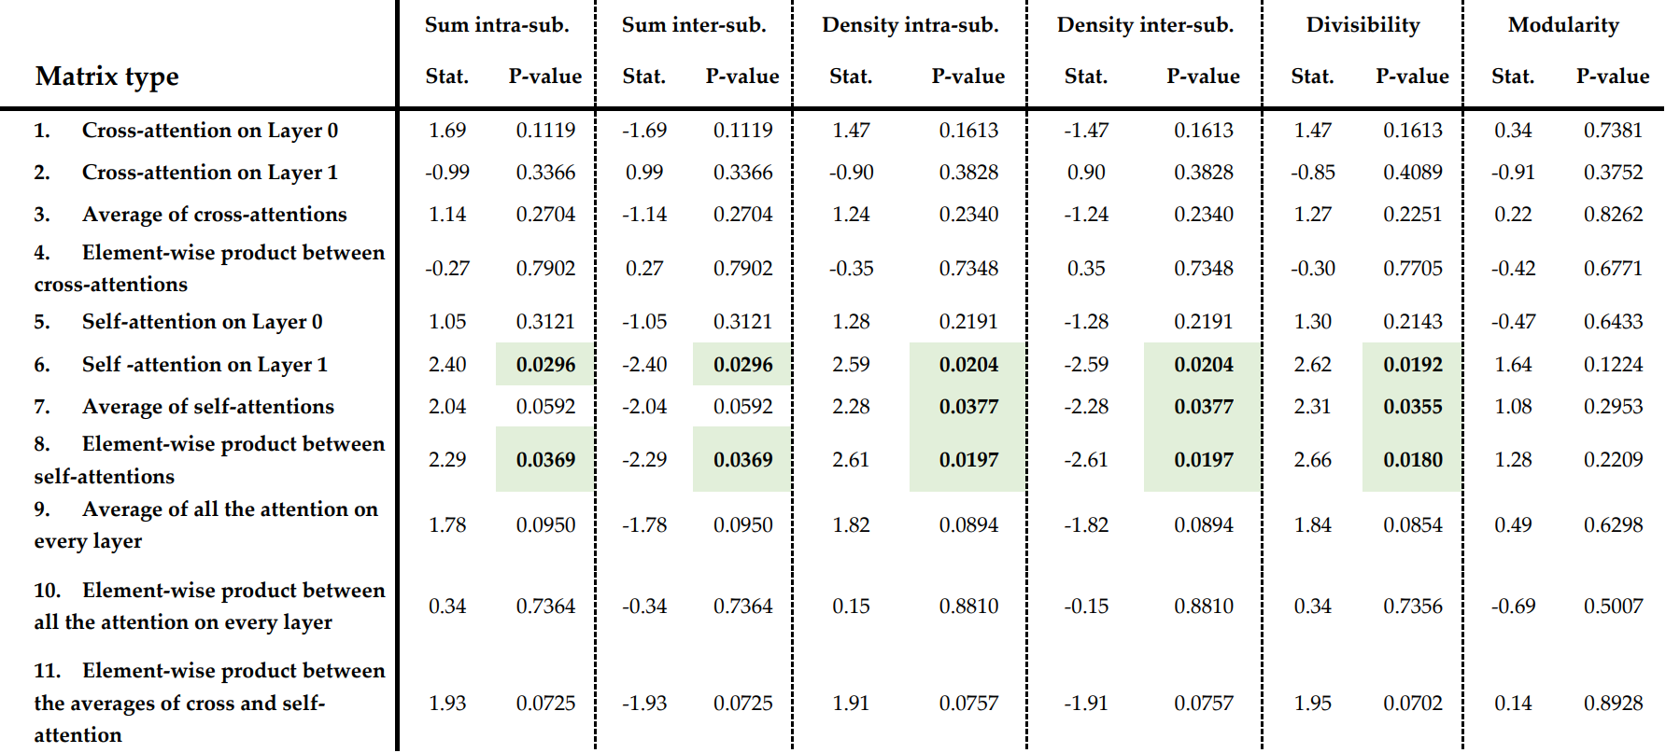

Results of Method 2 - Table of t-tests
Notes:
The second aim is to leverage the explainability properties of the Spacetimeformer architecture to estimate brain connectivity by inspecting computed attention. My hypothesis is that the attention computed by the model may be seen as a form of causality in the predictive sense, and a combination of them may be used as the weights of the connectivity graph to be estimated.

Slide 17
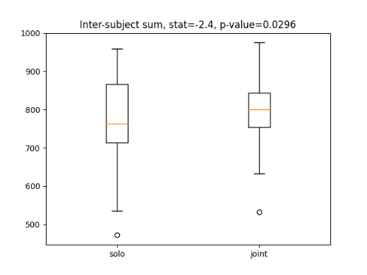
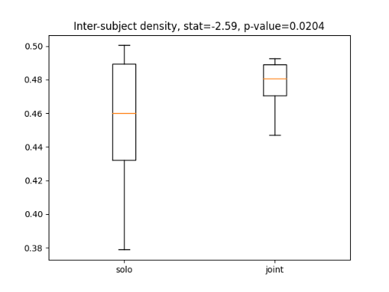
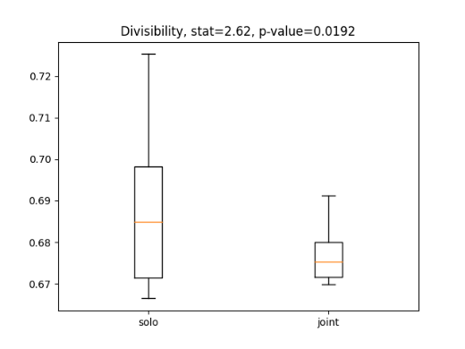
Results of Method 2 – Self-attention on Layer 1
Inter-subject sum
Inter-subject density
Divisibility
Solo condition
Joint condition
SOLO
SUB. A
SUB. B
SUB. A
SUB. B
Notes:
The second aim is to leverage the explainability properties of the Spacetimeformer architecture to estimate brain connectivity by inspecting computed attention. My hypothesis is that the attention computed by the model may be seen as a form of causality in the predictive sense, and a combination of them may be used as the weights of the connectivity graph to be estimated.

Slide 18
Results of Method 2 – Self-attention on Layer 1
Inter-subject sum
Inter-subject density
Divisibility
Solo condition
Joint condition
JOINT
SUB. A
SUB. B
SUB. A
SUB. B
Notes:
The second aim is to leverage the explainability properties of the Spacetimeformer architecture to estimate brain connectivity by inspecting computed attention. My hypothesis is that the attention computed by the model may be seen as a form of causality in the predictive sense, and a combination of them may be used as the weights of the connectivity graph to be estimated.

Slide 19
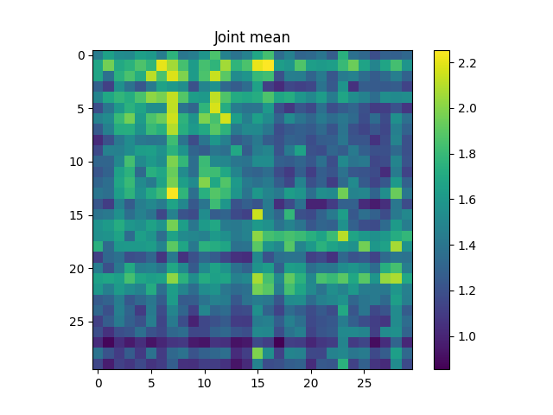
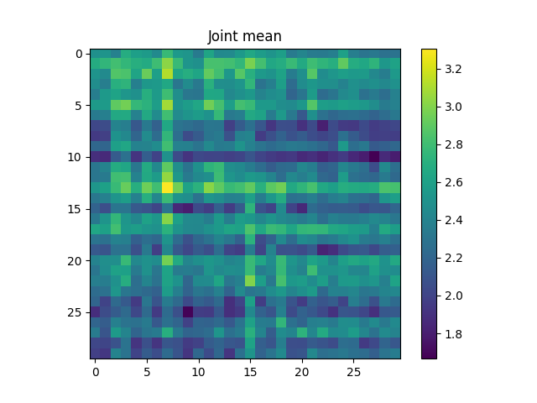
Results of Method 2 – Significant types of aggregations
Layer 1
EW PRODUCT
AVG
Layer 0
Notes:
The second aim is to leverage the explainability properties of the Spacetimeformer architecture to estimate brain connectivity by inspecting computed attention. My hypothesis is that the attention computed by the model may be seen as a form of causality in the predictive sense, and a combination of them may be used as the weights of the connectivity graph to be estimated.

Slide 20
Conclusion
Method 1
Modify Conditioned Granger Causality with Spacetimeformer
The novel approach showed performances comparable to those of the Linear Conditioned Granger causality method.
Long computational times, (around 600 min on a Tesla T4 on a hyperscanning dyad).
Method 2
Use attention matrices as a causality measure
The method provided physiologically meaningful and sound results, supported by statistical evidence.
Computational times are sensibly lower (more then 30 times lower, 15-20 min on a Tesla T4 on a hyperscanning dyad).
Notes:
The goal is to assess the feasibility of the novel approach, using synthetic EEG data as a benchmark to compare results with a ground truth. The hypothesis is that the novel approach can show performances comparable to those of the Linear Conditioned Granger causality method. The application of the method on real data is dependent on computational times, which are expected to be a possible criticality.
Computational times are expected to be sensibly lower.
For this reason, the aim is to assess the plausibility of this novel method by applying it to real hyperscanning EEG data.

Slide 21
Novelty and Future works
Novel aspects
I proposed two novel methods for the estimation of brain causality:
Base Conditioned Granger causality on Spacetimeformer residuals
Attention matrices as a measure of causality
First application of a Deep Learning method to EEG hyperscanning data.
Future research avenues
Experimenting with different aggregation functions.
Varying the number of decoder and encoder layers.
Correlating computed indices with behavioural data.
Using the same attention method for estimating temporal relationships.
Notes:
The goal is to assess the feasibility of the novel approach, using synthetic EEG data as a benchmark to compare results with a ground truth. The hypothesis is that the novel approach can show performances comparable to those of the Linear Conditioned Granger causality method. The application of the method on real data is dependent on computational times, which are expected to be a possible criticality.
Computational times are expected to be sensibly lower.
For this reason, the aim is to assess the plausibility of this novel method by applying it to real hyperscanning EEG data.

Slide 22
Thank you
Relatore: Prof.ssa Laura Astolfi
Correlatore: Prof. Nicola Toschi
Controrelatore: Prof. Luca Iocchi
Luca Maurici 1809678
Master Thesis – M.Sc. in Artificial Intelligence and Robotics
Notes:
Questa slide dovrebbe contenere le stesse informazioni del frontespizio della tesi (inclusi i riferimenti a relatore, correlatore e controrelatore)

